Slide 1
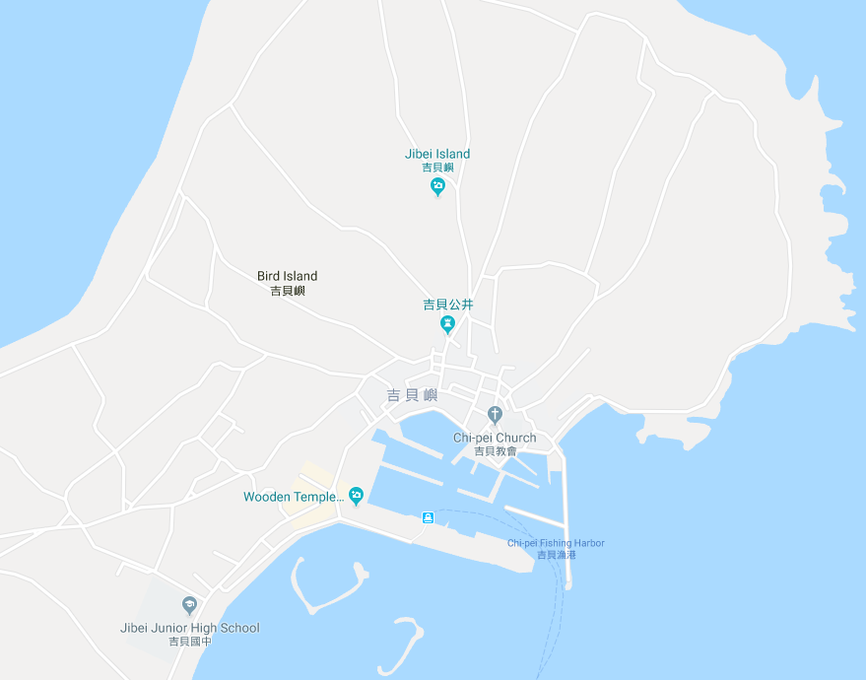





















Penghu County Baisha Township Jibei Village Evacuation Map
Disaster Prevention Information
Emergency Notification Unit
Penghu Emergency Operation Center TEL:06-9277619 Baisha Township Emergency Operation Center TEL:06-9931001 Baisha Police Station TEL:06-9931071 Baisha Fire Station TEL:06-9932119
Evacuation Principle
Flood:Stay away from low-lying area or go to evacuation shelter. Earthquake:Go to open space or evacuation shelter. Tsunami:Stay away from coastal low-lying area and take refuge in the nearby highland.
Evacuation Shelter
Name | Jibei Community Activity Center
Area | 360 m²
Capacity | 89 people
Address | No. 1-1, Jibei, Baisha Township
TEL | 06-9911241
Name | Square
Area | 4,000 m²
Capacity | 1,000 people
Name | Jibei Elementary School
Area | 112 m²
Capacity | 28 people
Address | No. 8, Jibei, Baisha Township
TEL | 06-9911086
Name | Jibei Junior High School
Area | 720 m²
Capacity | 180 people
Address | No. 185, Jibei, Baisha Township
TEL | 06-9911090
Made in March 2023 by Baisha Township Office, Penghu County
Jibei Village
Square
Jibei Police Station
Jibei Community Activity Center
Jibei Elementary School
Jibei Public Health Center
Helipad
Jibei Fire Station
Jibei Junior High School
Legend | Labelling |  | Facility
 | Evacuation Route | Shelter for Flood | Indoor Evacuation Shelter | Park | Medical Facility
 | Flooded Area | Shelter for Earthquake | Outdoor Evacuation Shelter | Police Department
 | Continuous Monitored Area | Shelter for Tsunami | Helipad | Fire Department

