Slide 1
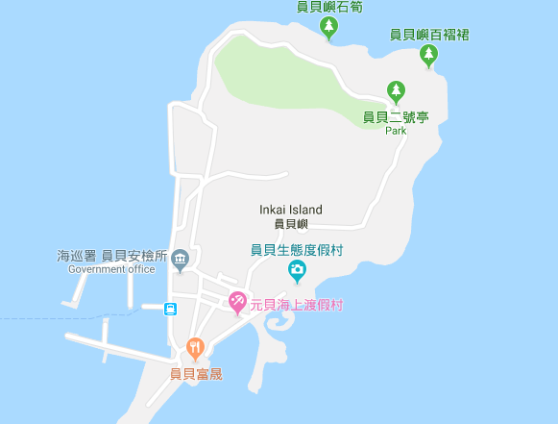




















Penghu County Baisha Township Yuanbei Village Evacuation Map
Disaster Prevention Information
Emergency Notification Unit
Penghu Emergency Operation Center TEL:06-9277619 Baisha Township Emergency Operation Center TEL:06-9931001 Yuanbei Police Station TEL:06-9933799 Yuanbei Fire Station TEL:06-9911119
Evacuation Principle
Flood:Stay away from low-lying area or go to evacuation shelter. Earthquake:Go to open space or evacuation shelter. Tsunami:Stay away from coastal low-lying area and take refuge in the nearby highland.
Evacuation Shelter
Name | Highland
Area | 1,000 m²
Capacity | 250 people
Name | Yuanbei Community Activity Center
Area | 80 m²
Capacity | 20 people
Address | No. 10-4, Yuanbei, Baisha Township
TEL | 06-9932759
Made in March 2023 by Baisha Township Office, Penghu County
Highland
Yuanbei Village
Yuanbei Public Health Center
Yuanbei Police Station
Yuanbei Community Activity Center
Yuanbei Fire Station
Legend | Labelling |  | Facility
 | Evacuation Route | Shelter for Flood | Indoor Evacuation Shelter | Park | Medical Facility
 | Flooded Area | Shelter for Earthquake | Outdoor Evacuation Shelter | Police Department
 | Continuous Monitored Area | Shelter for Tsunami | Helipad | Fire Department

