Slide 1
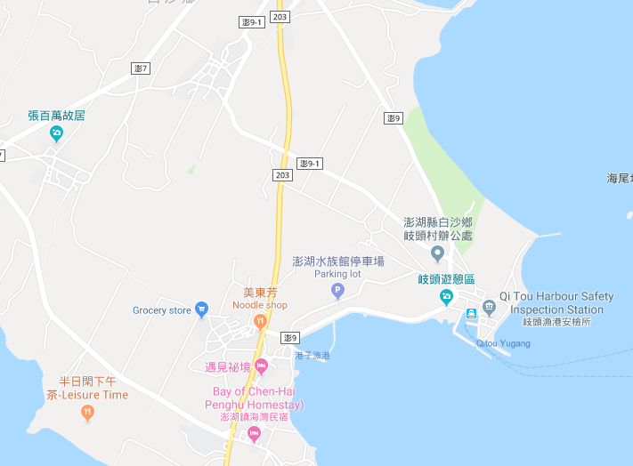

















Penghu County Baisha Township Gangzi Village Evacuation Map
Disaster Prevention Information
Emergency Notification Unit
Penghu Emergency Operation Center TEL:06-9277619 Baisha Township Emergency Operation Center TEL:06-9931001 Jiangmei Police Station TEL:06-9931501 Baisha Fire Station TEL:06-9932119
Evacuation Principle
Flood:Stay away from low-lying area or go to evacuation shelter. Earthquake:Go to open space or evacuation shelter. Tsunami:Stay away from coastal low-lying area and take refuge in the nearby highland.
Evacuation Shelter
Name | Gangzi Community Activity Center
Area | 157 m²
Capacity | 35 people
Address | No. 23-2, Gangzi, Baisha Township
TEL | 06-9931012
Name | Square
Area | 4,000 m²
Capacity | 1,000 people
Made in March 2023 by Baisha Township Office, Penghu County
Square
Gangzi Village
Gangzi Community Activity Center
Legend | Labelling |  | Facility
 | Evacuation Route | Shelter for Flood | Indoor Evacuation Shelter | Park | Medical Facility
 | Flooded Area | Shelter for Earthquake | Outdoor Evacuation Shelter | Police Department
 | Continuous Monitored Area | Shelter for Tsunami | Helipad | Fire Department

