Slide 1
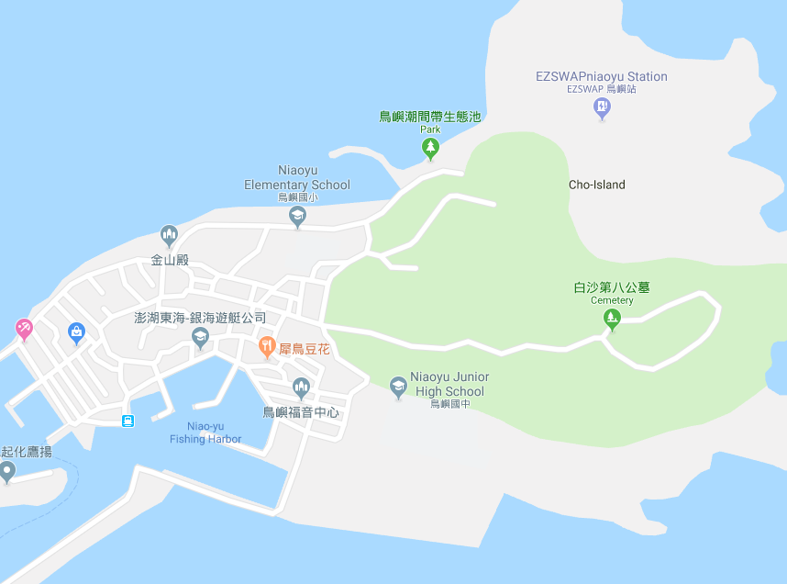




















Penghu County Baisha Township Niaoyu Village Evacuation Map
Disaster Prevention Information
Emergency Notification Unit
Penghu Emergency Operation Center TEL:06-9277619 Baisha Township Emergency Operation Center TEL:06-9931001 Niaoyu Police Station TEL:06-9916170 Niaoyu Fire Station TEL:06-9916119
Evacuation Principle
Flood:Stay away from low-lying area or go to evacuation shelter. Earthquake:Go to open space or evacuation shelter. Tsunami:Stay away from coastal low-lying area and take refuge in the nearby highland.
Evacuation Shelter
Name | Niaoyu Community Activity Center
Area | 265 m²
Capacity | 65 people
Address | No. 9-2, Niaoyu, Baisha Township
TEL | 06-9916004
Name | Highland
Area | 3,000 m²
Capacity | 750 people
Made in March 2022 by Baisha Township Office, Penghu County
Niaoyu Village
Highland
Niaoyu Police Station
Niaoyu Public Health Center
Niaoyu Community Activity Center
Niaoyu Fire Station
Legend | Labelling |  | Facility
 | Evacuation Route | Shelter for Flood | Indoor Evacuation Shelter | Park | Medical Facility
 | Flooded Area | Shelter for Earthquake | Outdoor Evacuation Shelter | Police Department
 | Continuous Monitored Area | Shelter for Tsunami | Helipad | Fire Department

