Slide 1
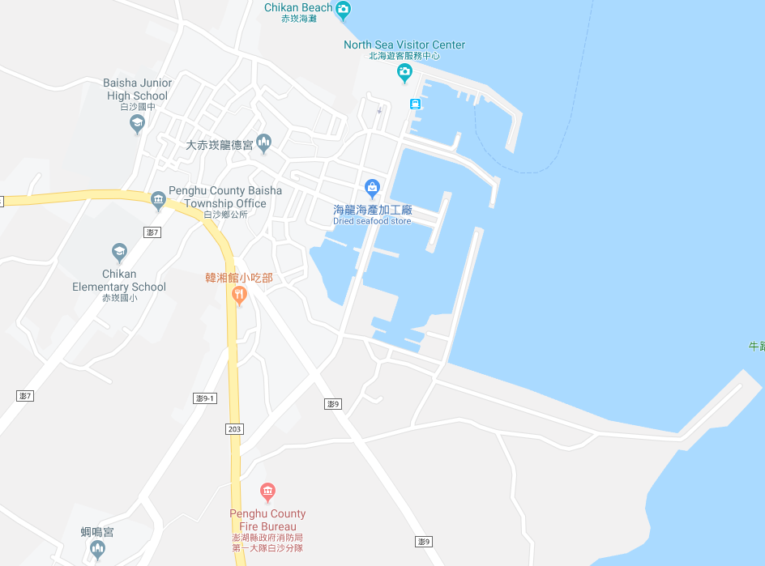




















Penghu County Baisha Township Chikan Village Evacuation Map
Disaster Prevention Information
Emergency Notification Unit
Penghu Emergency Operation Center TEL:06-9277619 Baisha Township Emergency Operation Center TEL:06-9931001 Baisha Police Station TEL:06-9931071 Baisha Fire Station TEL:06-9932119
Evacuation Principle
Flood:Stay away from low-lying area or go to evacuation shelter. Earthquake:Go to open space or evacuation shelter. Tsunami:Stay away from coastal low-lying area and take refuge in the nearby highland.
Evacuation Shelter
Name | Chikan Community Activity Center
Area | 180 m²
Capacity | 45 people
Address | No. 35, Chikan, Baisha Township
TEL | 06-9931008
Name | Square
Area | 5,000 m²
Capacity | 1,250 people
Name | Highland
Area | 4,000 m²
Capacity | 1,000 people
Name | Baisha Junior High School
Area | 98 m²
Capacity | 20 people
Address | No. 294, Chikan, Baisha Township
TEL | 06-9931006
Made in March 2022 by Baisha Township Office, Penghu County
Baisha Junior High School
Highland
Chikan Community Activity Center
Baisha Township Public Health Center
Baisha Police Station
Square
Park
Chikan Village
Baisha Fire Station
Legend | Labelling |  | Facility
 | Evacuation Route | Shelter for Flood | Indoor Evacuation Shelter | Park | Medical Facility
 | Flooded Area | Shelter for Earthquake | Outdoor Evacuation Shelter | Police Department
 | Continuous Monitored Area | Shelter for Tsunami | Helipad | Fire Department

